Slide 1
Design Patterns
Management of Software Systems

Slide 2
Design Patterns
A design pattern is a way of reusing abstract knowledge about a problem and its solution
A pattern is a description of the problem and essence of its solution
It should be sufficiently abstract to be reused in different settings
Patterns often rely on object characteristics such as inheritance and polymorphism

Slide 3
Pattern elements
Name
A meaningful pattern identifier
Problem description
Solution description
Not a concrete design but a template for a design solution that can be instantiated in different ways
Consequences
The results and trade-offs applying the pattern

Slide 4
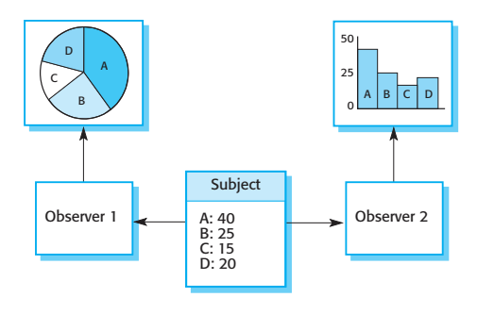
Multiple displays

Slide 5
Observer pattern
Name
Observer
Description
Solution description
See the slide with UML description
Consequences
Separates the display of object state from the object itself
Problem description
Used when multiple displays of the state are needed
Optimizations to enhance display performance are impractical

Slide 6
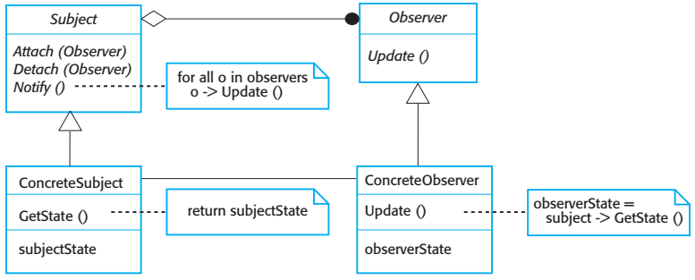
Observer pattern

Slide 7
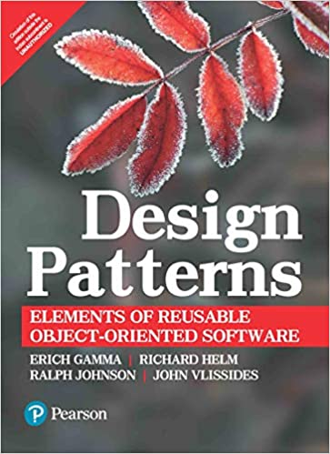
Other design patterns
To use patterns in your design, you need to recognize that any design problem you are facing may have an associated pattern that can be applied
Gang of Four’s original patterns book describe 23 patterns

Slide 8
Some design patterns
Tell several objects that the state of some other object has changed
(Observer pattern).
Tidy up the interfaces to a number of related objects that have often been developed incrementally
(Façade pattern)
Provide a standard way of accessing the elements in a collection, irrespective of how that collection is implemented
(Iterator pattern).
Allow for the possibility of extending the functionality of an existing class at runtime
(Decorator pattern).

Slide 9
Patterns for high level concept reuse
When you try to reuse executable components you are inevitably constrained by detailed design decisions that have been made by the implementers of these components.
These range from the particular algorithms that have been used to implement the components to the objects and types in the component interfaces.
When these design decisions conflict with your requirements, reusing the component is either impossible or introduces inefficiencies into your system.
Using patterns means that you reuse the ideas but can adapt the implementation to suit the system you are developing.

Slide 10
Finding a pattern
Using patterns in a design process often involves developing a design, experiencing a problem, and then recognizing that a pattern can be used.
This is certainly possible if you focus on the 23 general-purpose patterns documented in the original patterns book.
However, if your problem is a different one, you may find it difficult to find an appropriate pattern among the hundreds of different patterns that have been proposed

Slide 11
Effective use of design patterns
Patterns are a great idea, but you need experience of software design to use them effectively.
You have to recognize situations where a pattern can be applied.
Inexperienced programmers, even if they have read the pattern books, will always find it hard to decide whether they can reuse a pattern or need to develop a special-purpose solution

Slide 12
23 design patterns
1. Strategy
Defines a family of algorithms, encapsulates each one, and make them interchangeable. Strategy lets the algorithm vary independently from clients who use it.
2. Decorator
Attach additional responsibilities to an object dynamically. Decorators provide a flexible alternative to subclassing for extending functionality.
3. Factory Method
Define an interface for creating an object, but let the subclasses decide which class to instantiate. Factory Method lets a class defer instantiation to subclasses.
4. Observer
Define a one-to-many dependency between objects so that when one object changes state, all its dependents are notified and updated automatically.

Slide 13
23 design patterns
5. Chain of Responsibility
Avoid coupling the sender of a request to its receiver by giving more then one object a chance to handle the request. Chain the receiving objects and pass the request along the chain until an object handles it.
6. Singleton
Ensure a class only has one instance, and provide a global point of access to it.
7. Flyweight
Use sharing to support large numbers of fine-grained objects efficiently. A flyweight is a shared object that can be used in multiple contexts simultaneously. The flyweight acts as an independent object in each context; it’s indistinguishable from an instance of the object that’s not shared.
8. Adapter
Convert the interface of a class into another interface clients expect. Adapter lets classes work together that couldn’t otherwise because of incompatibility interfaces.

Slide 14
23 design patterns
9. Façade
Provide a unified interface to a set of interfaces in a system. Façade defines a higher-level interface that makes the subsystem easier to use.
10. Template
Define a skeleton of an algorithm in an operation, deferring some steps to subclasses. Template Method lets subclasses redefine certain steps of an algorithm without changing the algorithms structure.
11. Builder
Separate the construction of a complex object from its representation so that the same construction processes can create different representations.
12. Iterator
Provide a way to access the elements of an aggregate object sequentially without exposing its underlying representation.

Slide 15
23 design patterns
13. Composite
Compose objects into tree structures to represent part-whole hierarchies. Composite lets clients treat individual objects and compositions of objects uniformly.
14. Command
Encapsulate a request as an object, thereby letting you parameterize clients with different requests, queue or log requests, and support undoable operations.
15. Mediator
Define an object that encapsulates how a set of objects interact. Mediator promotes loose coupling by keeping objects from referring to each other explicitly, and lets you vary their interaction independently.
16. State
Allow an object to alter its behavior when its internal state changes. The object will appear to change its class.

Slide 16
23 design patterns
17. Proxy
Provide a surrogate or placeholder for another object to control access to it.
18. Abstract Factory
Provide an interface for creating families of related or dependent objects without specifying their concrete classes.
19. Bridge
Decouple an abstraction from its implementation so that the two can vary independently.
20. Interpreter
Given a language, define a representation for its grammar along with an interpreter that uses the representation to interpret sentences in the language.

Slide 17
23 design patterns
21. Memento
Without violating encapsulation, capture and externalize an object’s internal state so that the object can be restored to this state later.
22. Prototype
Specify the kinds of objects to create using a prototypical instance, and create new objects by copying this prototype.
23. Visitor
Represent an operation to be performed on the elements of an object structure. Visitor lets you define a new operation without changing the classes of the elements on which it operates.

Slide 18


